Slide 1
Project Night terror
Evan Geissler
Notes:
**Randomly generate where texts are, items are, placements, etc. Core static, other stuff different.

Slide 2
focus
1) Maps & Collectable Locations
2) General Things
3) Better Documentation
4) Area Design/Improvements
5) Menus & Collectables

Slide 3
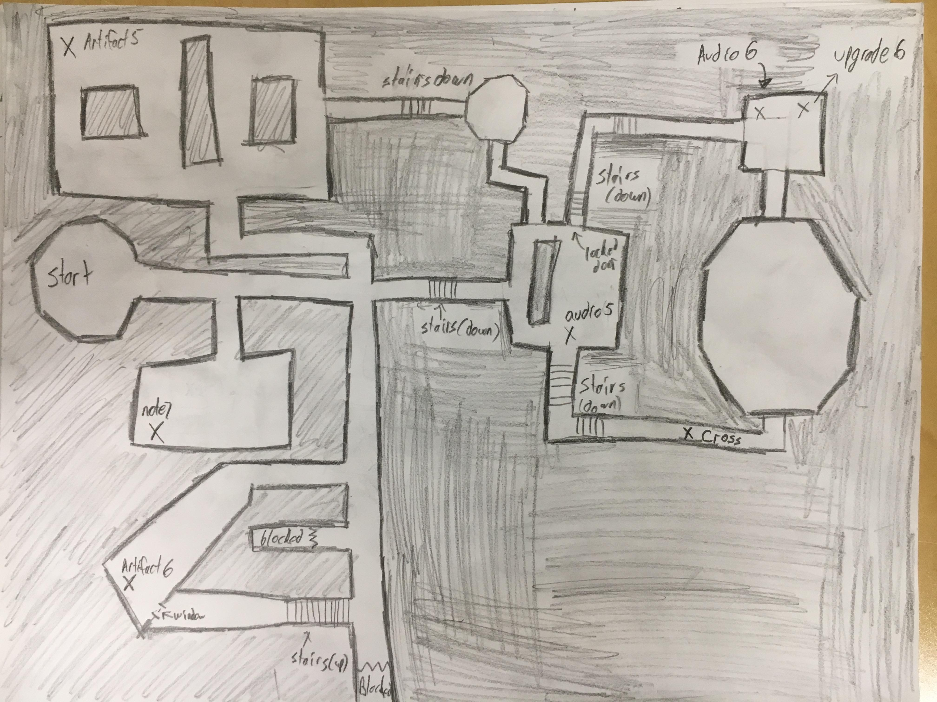
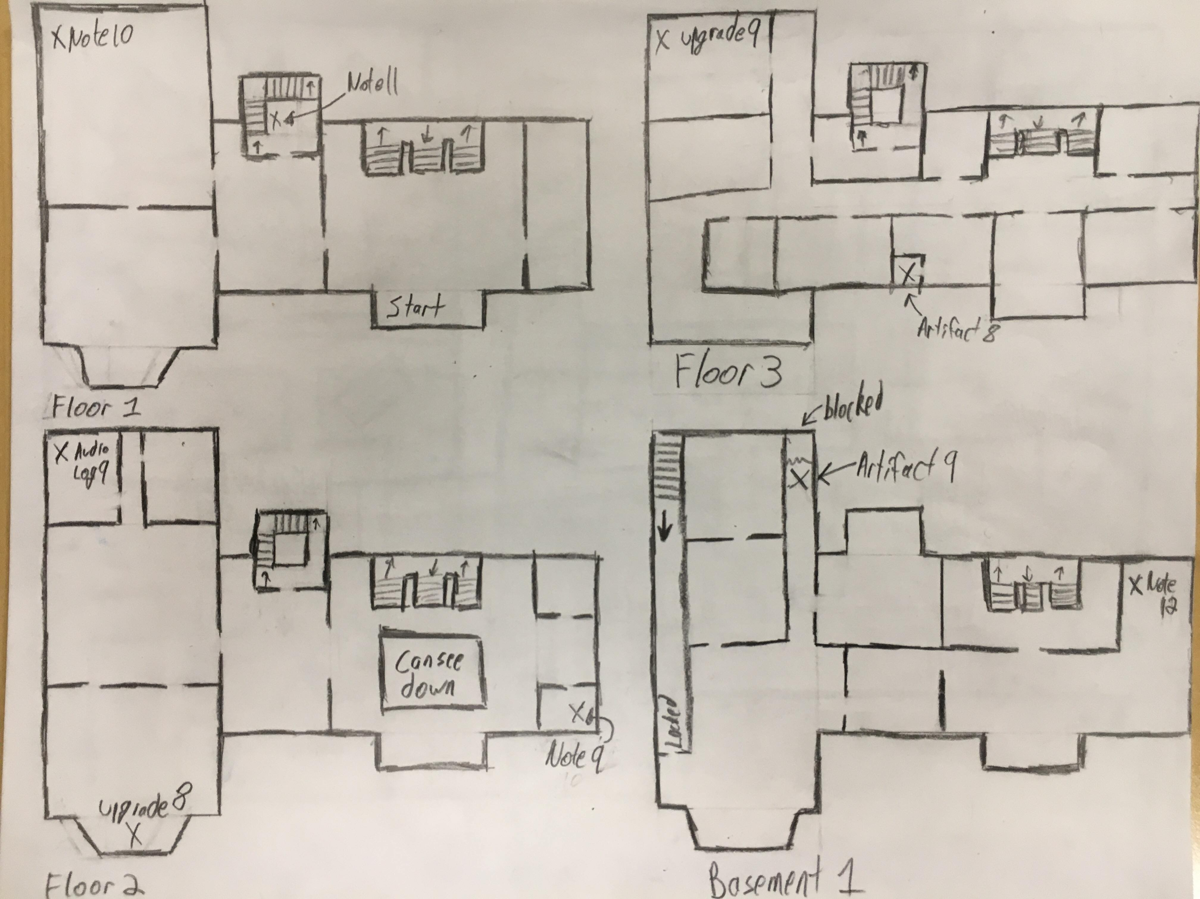
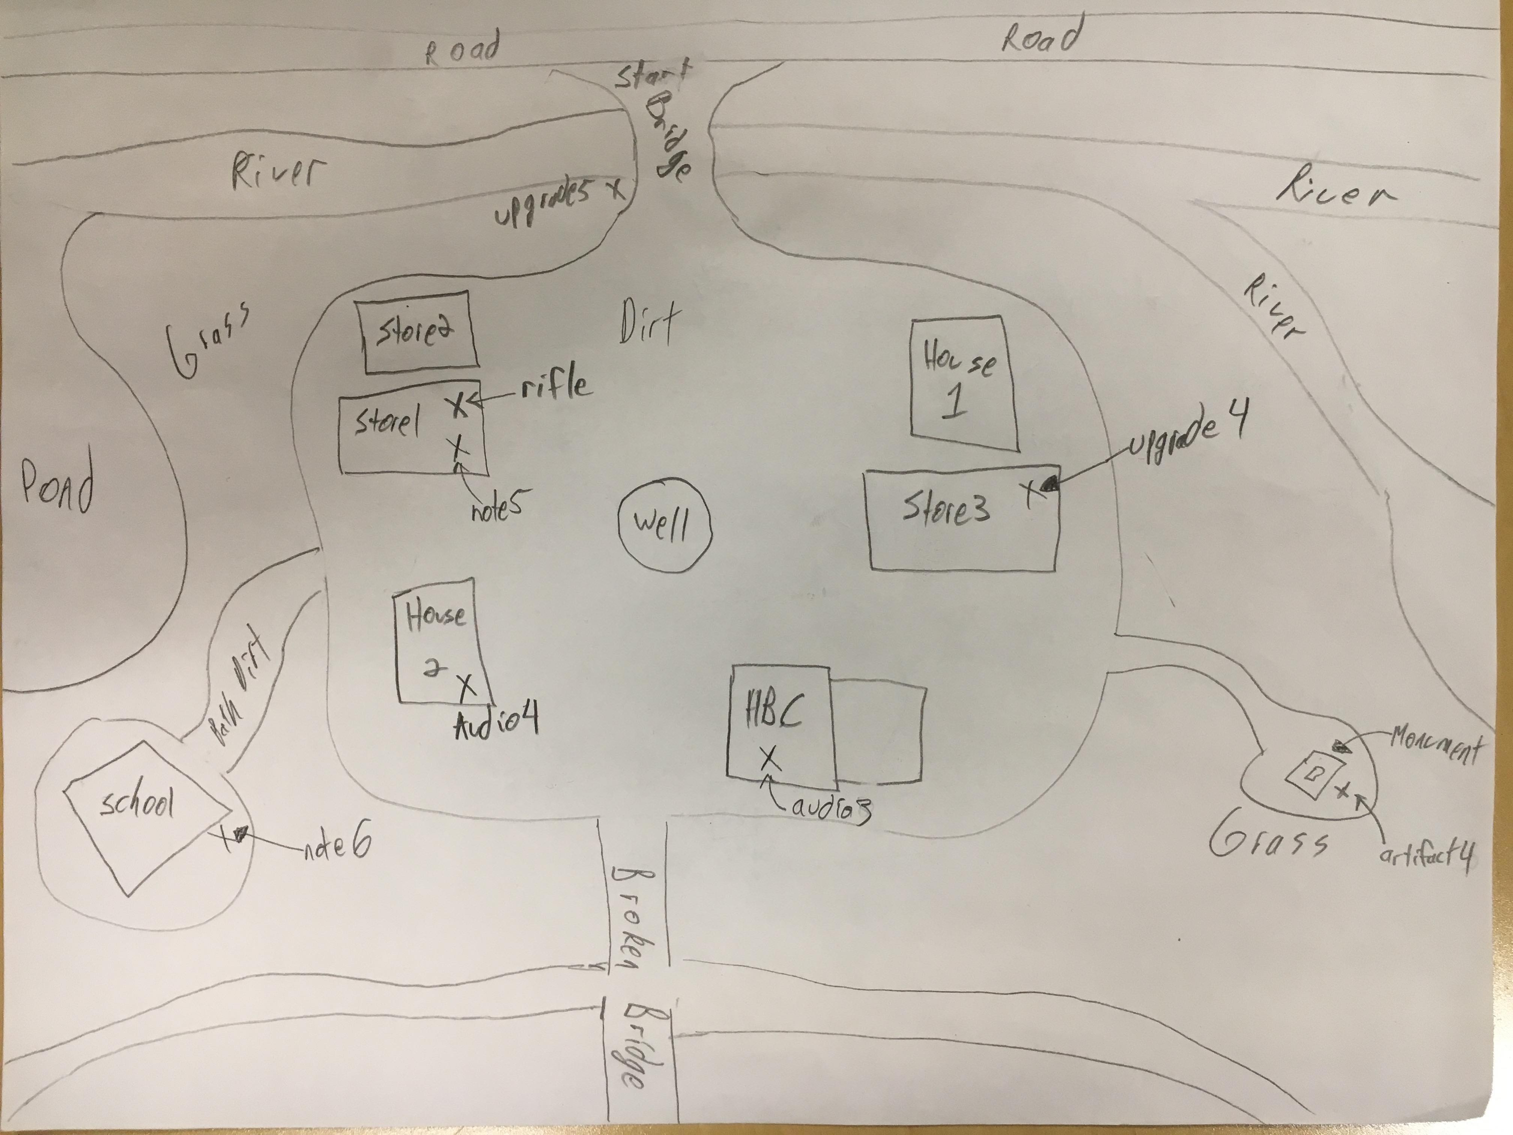
Maps & Collectable Locations

Slide 4
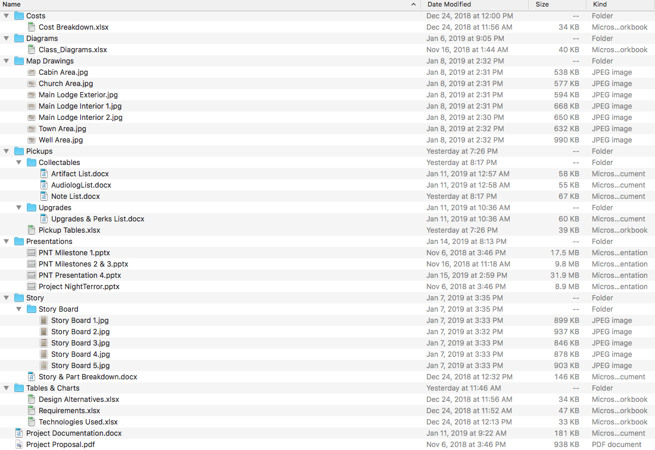
Better Documentation

Slide 5
General Things
Bug Fixes
Animation Updates (Character Movement)
Set up & Plan for next few months (AI, piece things together, etc.)
Cleaned up files
Possible new software for an improved/better landscape

Slide 6
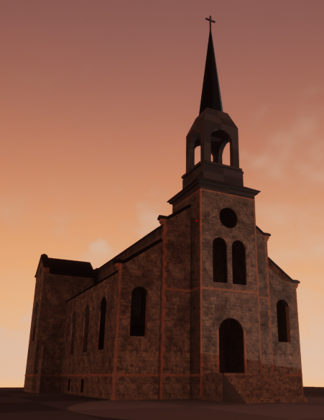
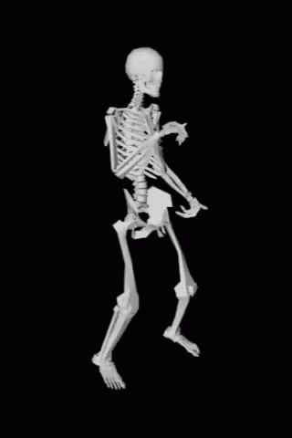
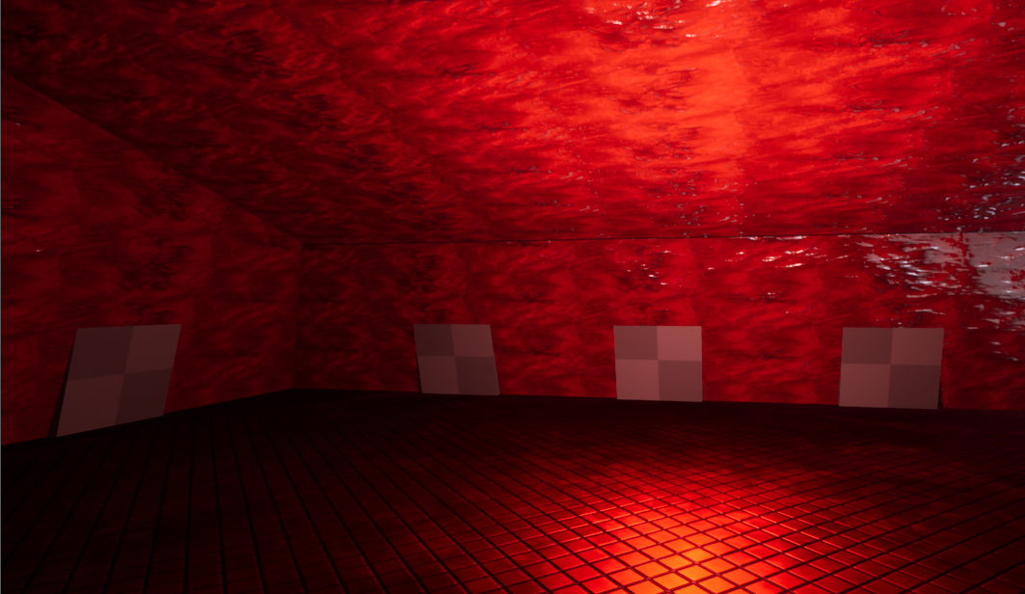
Area Design & Improvements
Church
Cabin Upstairs

Slide 7
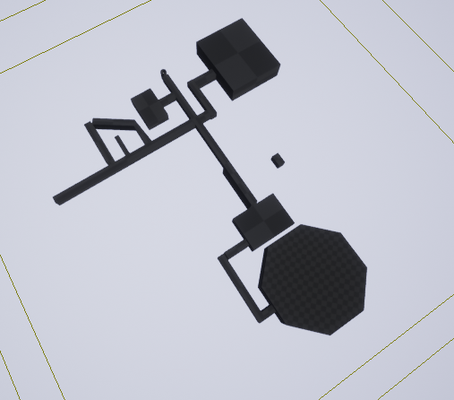
Area Design & Improvements
Well Area Implemented
Well Area Map Drawing

Slide 8
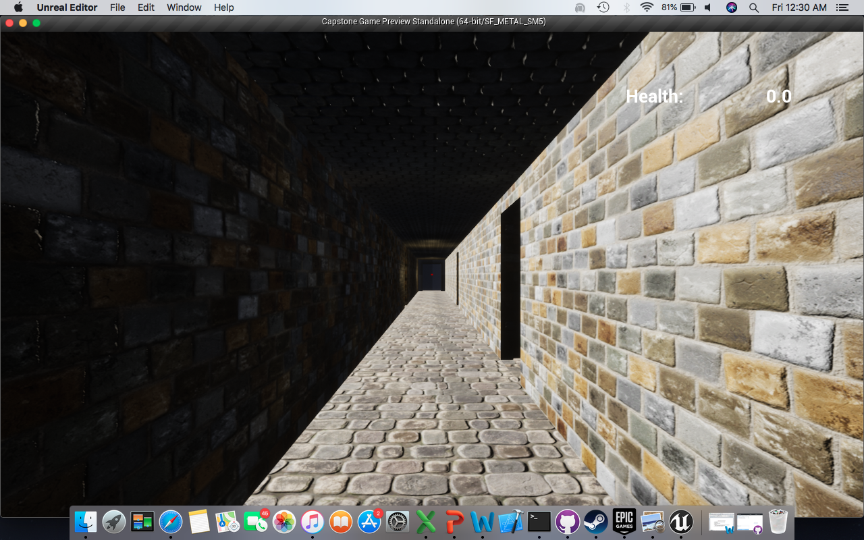
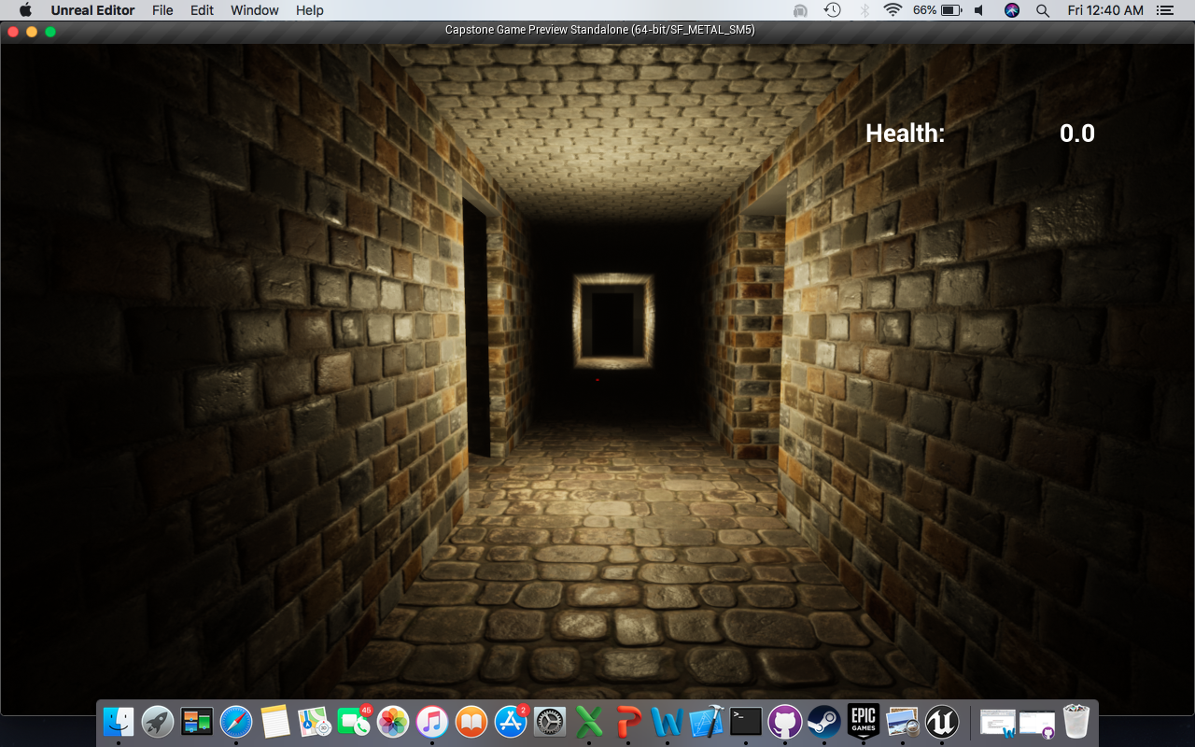
Area Design & Improvements
Before Lighting Build
After Lighting Build

Slide 9
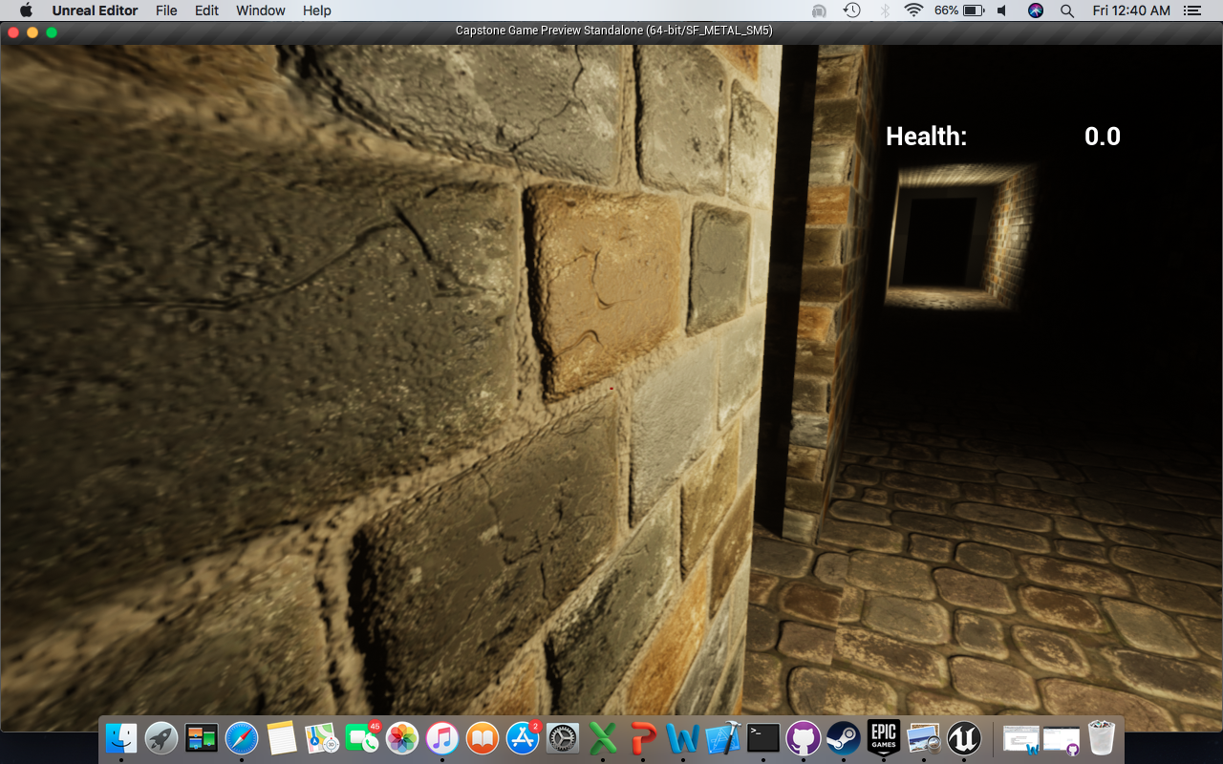
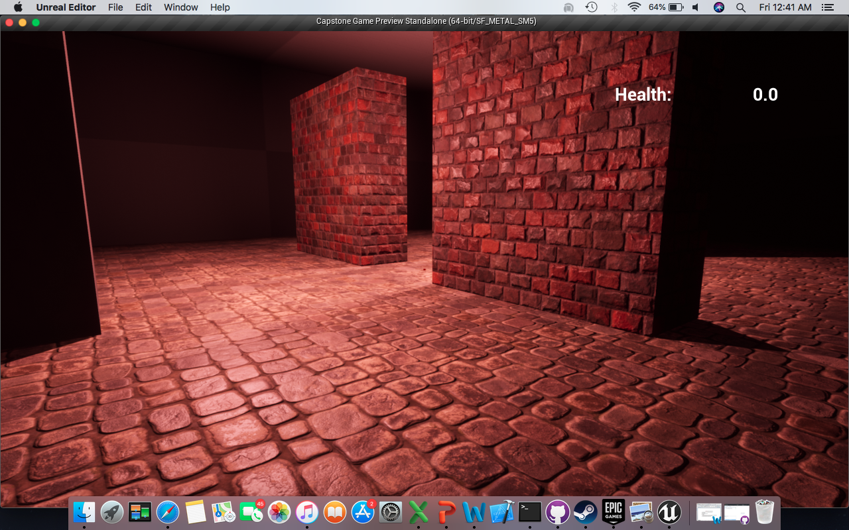
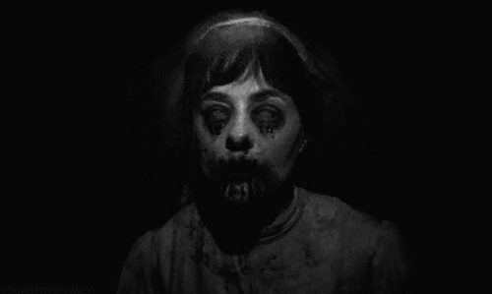
Area Design & Improvements
Wall Close Up
Room in Well

Slide 10
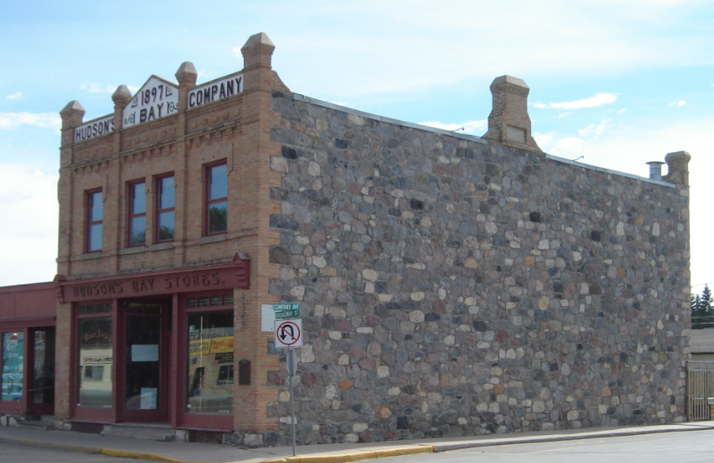
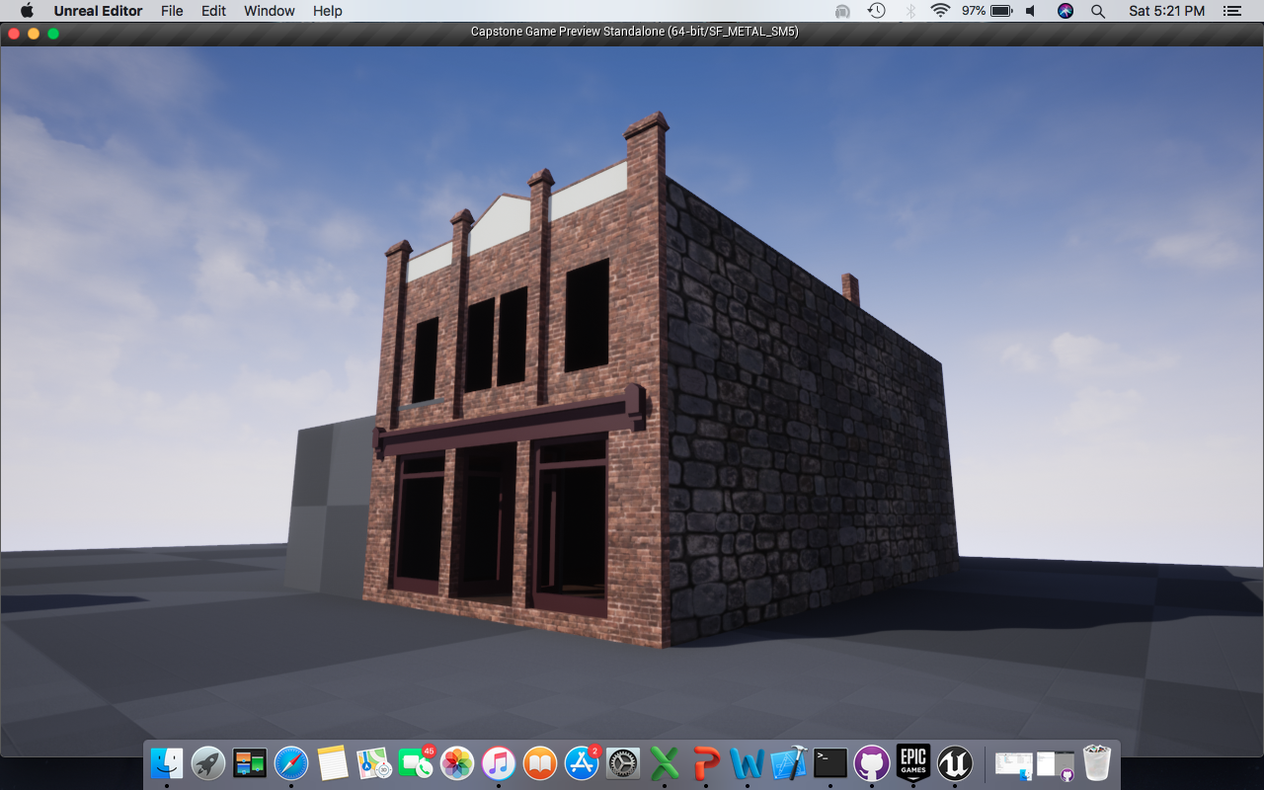
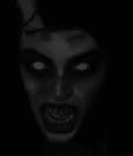
Area Design
Hudson’s Bay Store
In Game (So far)

Slide 11
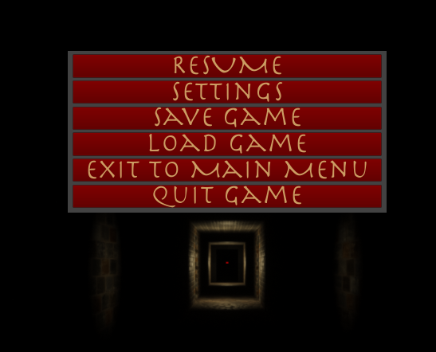
Menus
Pause Menu

Slide 12
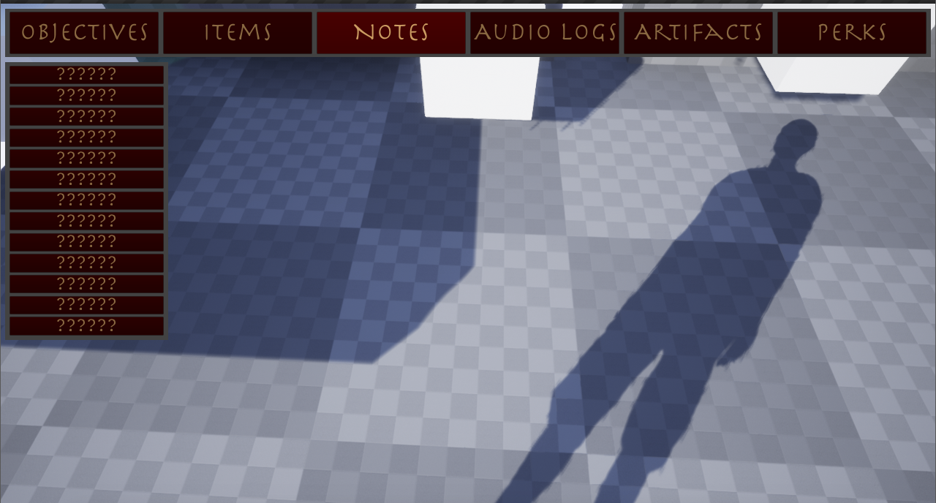
Menus & Collectables
Before Picking Up Note

Slide 13
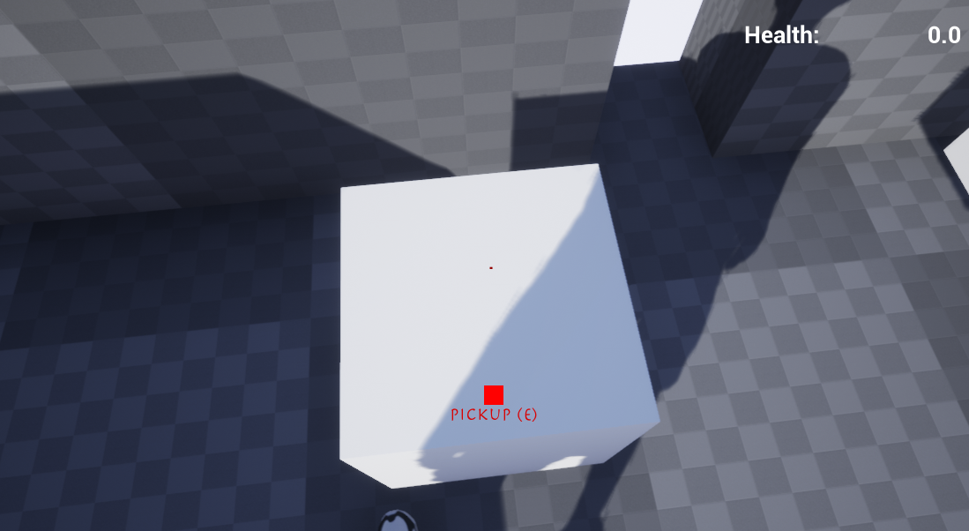
Menus & Collectables
Picking up an Item/Collectable

Slide 14
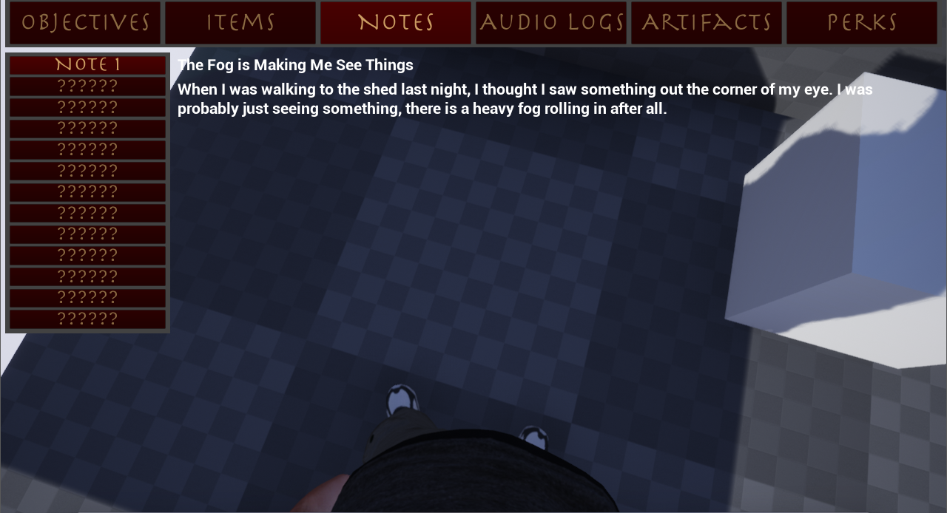
Menus & Collectables
After Picking Up Note

Slide 15

Testing

